Slide 1
DOM IN JAVASCRIPT
Understanding DOM
By Hamza GUERMAJ

Slide 2

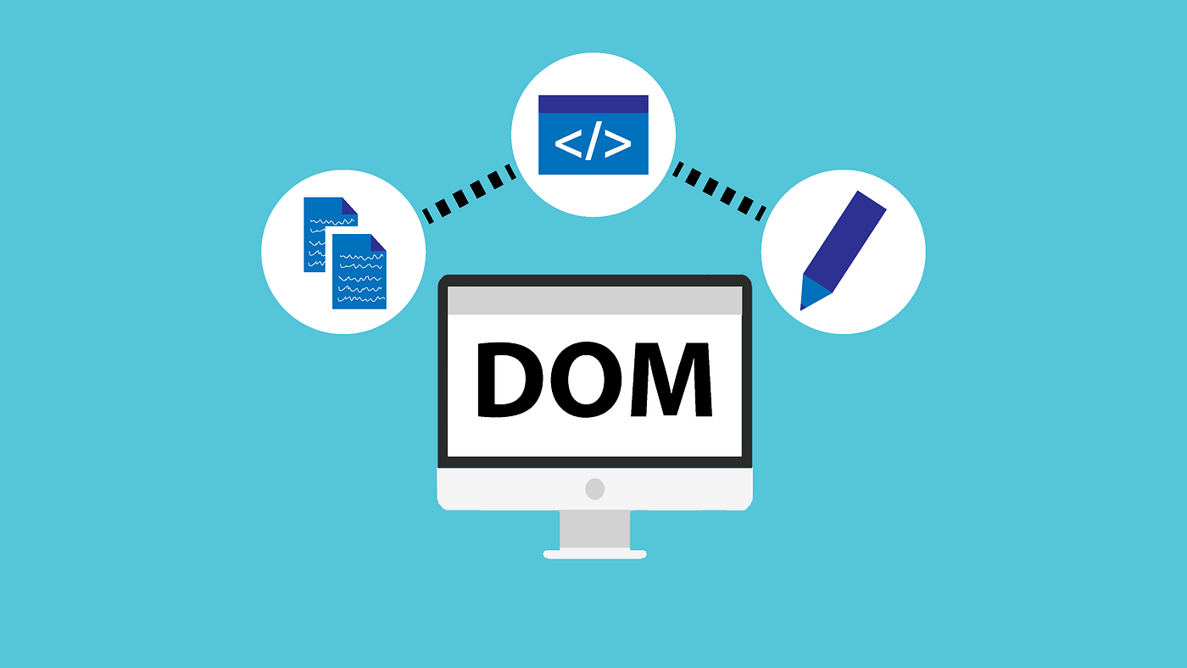
Introduction:
The Document Object Model (DOM) is a programming interface for web documents, allowing dynamic manipulation of web page content.
Essential for building interactive and responsive web applications

Slide 3
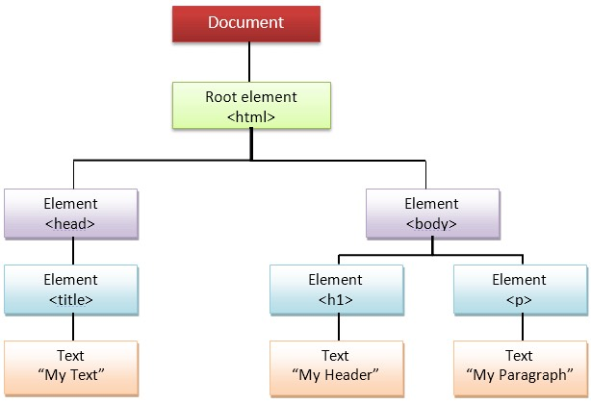
The DOM tree
Representation: A hierarchical tree structure.
Elements: HTML elements represented as objects.
Hierarchy: document > html > head, body > …

Slide 4

Accessing elements
Methods :
document.getElementById('elementId')
document.getElementsByClassName('className')
document.getElementsByTagName('tagName')
document.querySelector('selector')
document.querySelectorAll(‘selector’)
Example:

Slide 5
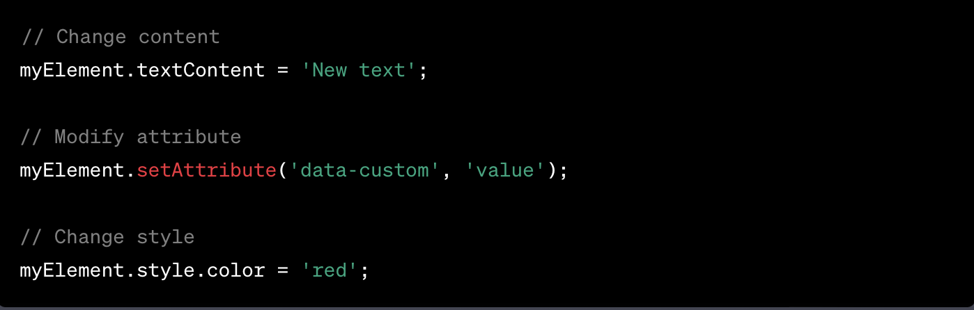
Manipulating Elements
Change Content: Use innerHTML, textContent, or innerText.
Modify Attributes: setAttribute( ), getAttribute( ).
Change Styles: Modify the style property.
Example:

Slide 6
Traversing in DOM
Navigation Methods: parentNode, childNodes, nextSibling, previousSibling.
Example:

Slide 7
Creating and Deleting elements:
Create Elements: document.createElement('tagName').
Add to DOM: appendChild( ), insertBefore( ).
Remove Elements: removeChild( ).
Example:

Slide 8
Events
Listening for Events: Use addEventListener( ).
Event Handlers: JavaScript functions that execute when events occur.
Example:

Slide 9
To consider
Best Practices
Performance: Minimize DOM manipulation for speed.
Caching: Store references to frequently used elements.
Event Delegation: Efficiently handle events for multiple elements
Cross-Browser Compatibility
Differences: Browsers may have variations in DOM implementations.
Modern Solutions: Modern JavaScript and web standards improve cross-browser compatibility.
Security Considerations
Sanitization: Be cautious when using user input to manipulate the DOM.
Vulnerabilities: Improper handling can lead to security issues like Cross-Site Scripting (XSS).

Slide 10
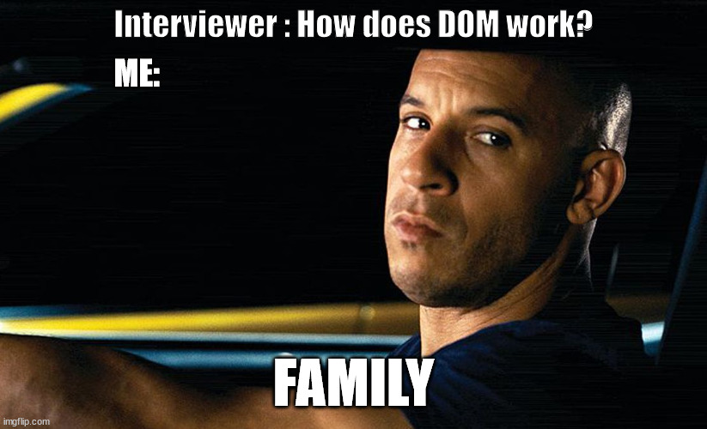
Conclusion
The DOM is fundamental for web development.
Allows dynamic interaction and manipulation of web pages.
Mastering DOM manipulation is key to building modern web applications.

Slide 11
Thanks for your attention.
Any Questions…?

